Slide 1


SHAIMA AFREEN
22-09-2022

Slide 2

Outline
Executive Summary
Introduction
Methodology
Results
Conclusion
Appendix

Slide 3
Executive Summary
Summary of methodologies
Data Collection Through API
Data collection using Web Scraping
Data Wrangling
Explorative Data Analysis using SQL
Explorative Data Analysis using Visualization
Building Interactive Maps using Folium
Building a Dashboard using Plotly Dash
Machine Learning Prediction
Summary of all results
Explorative Data Analysis results
Interactive Analytics results in screenshots
Predictive Analysis results.

Slide 4
Introduction
Project background and context
Space X advertises Falcon 9 rocket launches on its website with a cost of 62 million dollars; other providers cost upward of 165 million dollars each, much of the savings is because Space X can reuse the first stage. Therefore, if we can determine if the first stage will land, we can determine the cost of a launch. This information can be used if an alternate company wants to bid against space X for a rocket launch. This goal of the project is to predict if the first stage will land successfully.
Problems you want to find answers
What factors determine if the rocket will land successfully?
The interaction amongst various features that determine the success rate of a successful landing.
What operating conditions needs to be in place to ensure a successful landing program

Slide 5

Section 1

Slide 6
Methodology
Executive Summary
Data collection methodology:
Data was collected using SpaceX API and web scraping from Wikipedia.
Perform data wrangling
One-hot encoding was applied to categorical features.
Perform exploratory data analysis (EDA) using visualization and SQL
Different graphs were plotted to show relationship between different variables.
Perform interactive visual analytics using Folium and Plotly Dash
Perform predictive analysis using classification models
How to build, tune, evaluate classification models

Slide 7
Data Collection
Data sets were collected as:
Data collection was done using “get request” to the SpaceX API.
This API gave us data about Launches, rockets used, payload delivered, launch specifications, landing specifications and landing outcomes.
Next, we decoded the response content as a Json using .json() function call and turn it into a pandas dataframe using .json_normalize().
We then cleaned the data, checked for missing values and fill in missing values where necessary.
In addition, we performed web scraping from Wikipedia for Falcon 9 launch records with BeautifulSoup.
The objective was to extract the launch records as HTML table, parse the table and convert it to a pandas dataframe for future analysis.

Slide 8
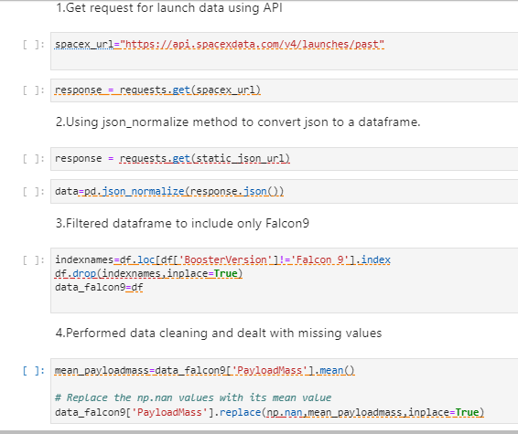
Data Collection – SpaceX API
We used the get request to the SpaceX API to collect data, clean the requested data and did some basic data wrangling and formatting.
The link to notebook:
https://github.com/ShaimaAfreen14/DataScience_Capstone_SpaceX/blob/main/Data%20Collection.ipynb

Slide 9
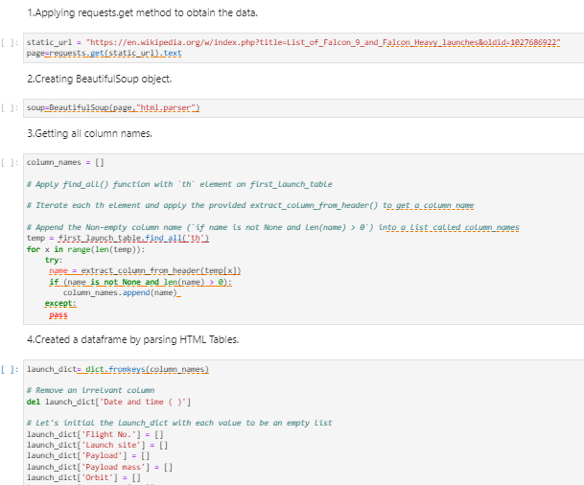
Data Collection - Scraping
We applied web scrapping to webscrape Falcon 9 launch records with BeautifulSoup
We parsed the table and converted it into a pandas dataframe.
Link to notebook:
https://github.com/ShaimaAfreen14/DataScience_Capstone_SpaceX/blob/main/Data%20Collection%20using%20web%20scraping.ipynb

Slide 10
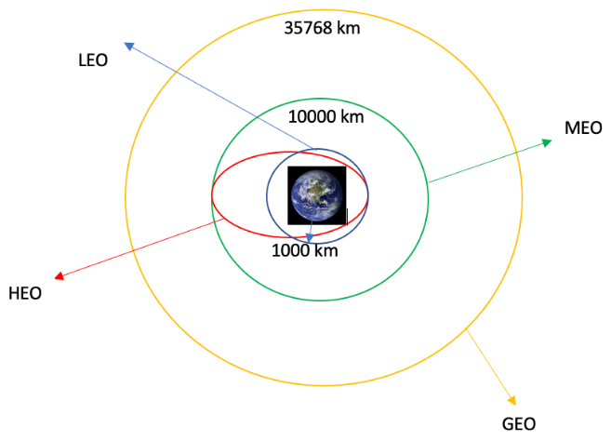
Data Wrangling
We performed exploratory data analysis and determined the training labels.
We calculated the number of launches at each site, and the number and occurrence of each orbits
We created landing outcome label from outcome column and exported the results to csv.
The link to the notebook is:
https://github.com/ShaimaAfreen14/DataScience_Capstone_SpaceX/blob/main/Data%20Wrangling.ipynb

Slide 11
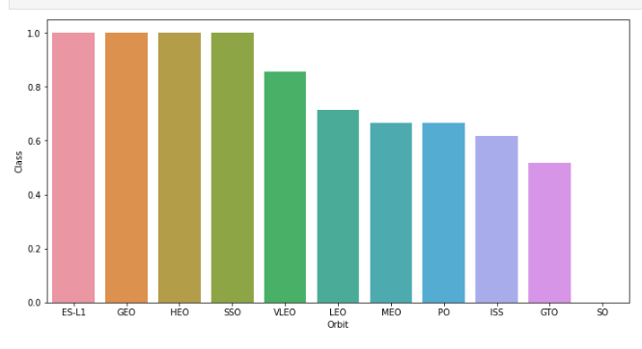
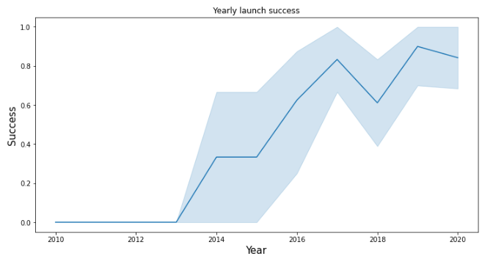
EDA with Data Visualization
We explored the data by visualizing the relationship between flight number and launch Site, payload and launch site, success rate of each orbit type, flight number and orbit type, the launch success yearly
Github URL:
https://github.com/ShaimaAfreen14/DataScience_Capstone_SpaceX/blob/main/EDA%20using%20Matplotlib.ipynb
A Bar Graph to analyse which orbits have high success rate.
A line graph to get yearly launch success

Slide 12
EDA with SQL
First we stored the dataset in a batabase table.
To get insight from the data we performed following sql queries:
Displayed the names of the unique launch sites in the space mission
Displayed 5 records where launch sites begin with the string 'CCA'
Displayed the total payload mass carried by boosters launched by NASA (CRS)
Displayed average payload mass carried by booster version F9 v1.1
Listed the date when the first successful landing outcome in ground pad was acheived.
Listed the names of the boosters which have success in drone ship and have payload mass greater than 4000 but less than 6000
Listed the total number of successful and failure mission outcomes
Listed the names of the booster_versions which have carried the maximum payload mass. Use a subquery
Listed the failed landing_outcomes in drone ship, their booster versions, and launch site names for in year 2015
Ranked the count of landing outcomes (such as Failure (drone ship) or Success (ground pad)) between the date 2010-06-04 and 2017-03-20, in descending order
Github URL:
https://github.com/ShaimaAfreen14/DataScience_Capstone_SpaceX/blob/main/EDA%20with%20SQL.ipynb

Slide 13
Build an Interactive Map with Folium
We marked all launch sites, and added map objects such as markers, circles, lines to mark the success or failure of launches for each site on the folium map.
We assigned the feature launch outcomes (failure or success) to class 0 and 1.i.e., 0 for failure, and 1 for success.
Using the color-labeled marker clusters, we identified which launch sites have relatively high success rate.
We calculated the distances between a launch site to its proximities. We answered some question for instance:
Are launch sites near railways, highways and coastlines.
Do launch sites keep certain distance away from cities.
GitHub URL:
https://github.com/ShaimaAfreen14/DataScience_Capstone_SpaceX/blob/main/Interactive%20Visual%20Analytics%20and%20Dashboard.ipynb

Slide 14
Build a Dashboard with Plotly Dash
We built an interactive dashboard with Plotly dash
We plotted pie charts showing the total launches by a certain site or all sites.
We plotted scatter graph showing the relationship with Outcome and Payload Mass (Kg) for the different booster version
GitHub URL:
https://github.com/ShaimaAfreen14/DataScience_Capstone_SpaceX/blob/main/Interactive%20Dashboard.py

Slide 15
Predictive Analysis (Classification)
Building Model:
We loaded the data using numpy and pandas
Transformed the data
Split our data into training and test data sets.
Built different machine learning models and tuned different hyperparameters using GridSearchCV.
Evaluating model:
Checked accuracy for each model.
Tuned hyperparameters for each type of algorithms.
Plotted confusion matrix.
Improving model:
Improved the model using feature engineering and algorithm tuning.
Found the best performing classification model.
GitHub URL:
https://github.com/ShaimaAfreen14/DataScience_Capstone_SpaceX/blob/main/Machine%20Learning%20Prediction.ipynb

Slide 16
Results
Exploratory data analysis results
Interactive analytics demo in screenshots
Predictive analysis results

Slide 17

Section 2

Slide 18
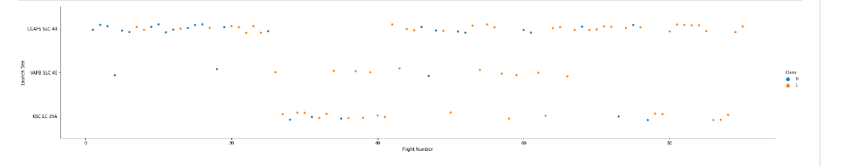
Flight Number vs. Launch Site
From the plot, we found that the larger the flight amount at a launch site, the greater the success rate at a launch site.

Slide 19
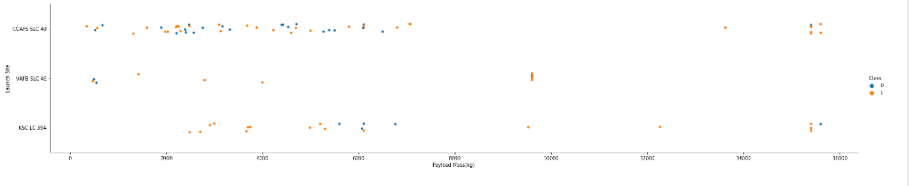
Payload vs. Launch Site
The greater the payload mass for Launch Site CCAFS SLC 40 the higher the success rate for the Rocket.

Slide 20
Success Rate vs. Orbit Type
From the plot, we can see that ES-L1, GEO, HEO, SSO, VLEO had the most success rate.

Slide 21
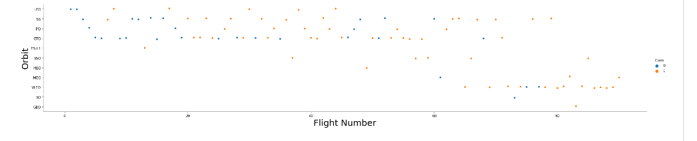
Flight Number vs. Orbit Type
The plot below shows the Flight Number vs. Orbit type. We observe that in the LEO orbit, success is related to the number of flights whereas in the GTO orbit, there is no relationship between flight number and the orbit.

Slide 22
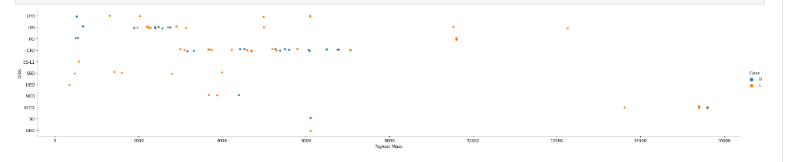
Payload vs. Orbit Type
We can observe that with heavy payloads, the successful landing are more for PO, LEO and ISS orbits.

Slide 23
Launch Success Yearly Trend
From the plot, we can observe that success rate since 2013 kept on increasing till 2020.

Slide 24
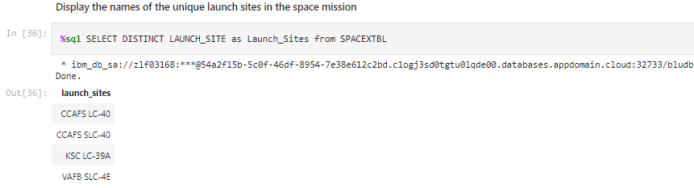
All Launch Site Names
Keyword DISTINCT is used to show unique items from the table.
We used the key word DISTINCT to show only unique launch sites from the SpaceX data.
Below is the query and it’s output:

Slide 25
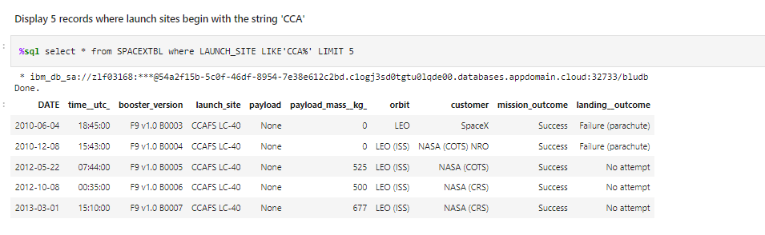
Launch Site Names Begin with 'CCA'
Here in where condition we use LIKE keyword where we use ‘CCA%’ which means it starts with CCA.
Here we are using ‘LIMIT’ to show only 5 rows.

Slide 26
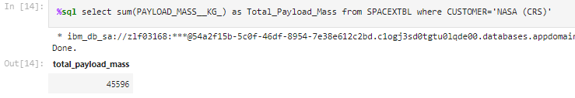
%sql select sum(PAYLOAD_MASS__KG_) as Total_Payload_Mass from SPACEXTBL where CUSTOMER='NASA (CRS)'
Total Payload Mass
Here we are displaying the total payload mass carried by boosters launched by NASA (CRS).
In the query we are applying Sum function on customer field to get the total payload mass by Nasa CRS.

Slide 27
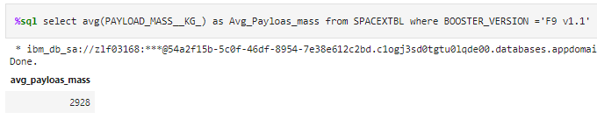
Average Payload Mass by F9 v1.1
Here we are applying avg() on Booster Version column to display the average payload mass carried by F9 v1.1.

Slide 28
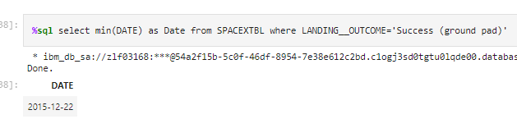
First Successful Ground Landing Date
This query is to display the date of the first successful landing outcome in ground pad.
In the query we are applying min() on Date column to get the very first landing date and in where clause we are specying the condition to only filter entries that have successful landing outcome in grounpad.

Slide 29
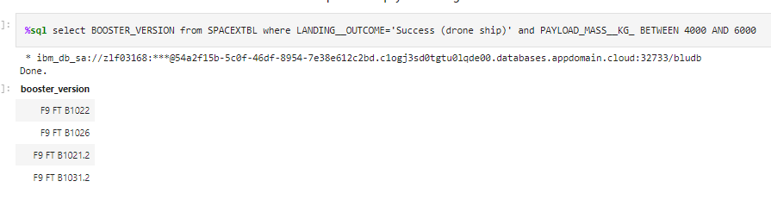
Successful Drone Ship Landing with Payload between 4000 and 6000
We are listing the names of boosters having success in droneship and having payload mass greater than 4000 but less than 6000
Since we have two conditions we use ‘and ’ in where clause.
To display payload mass greater than 4000 but less than 6000,we use “Between And ” operator.

Slide 30
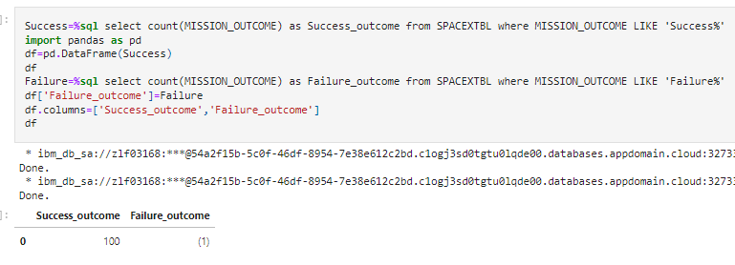
Total Number of Successful and Failure Mission Outcomes
We are applying count() on Mission Outcome column to get the successful and failure mission outcomes.
The result is then converted to a pandas dataframe.

Slide 31
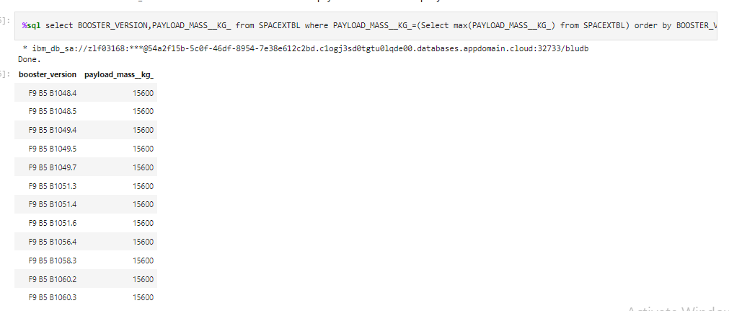
Boosters Carried Maximum Payload
We are listing the names of Booster versions which have carried the maximum payload mass.
We are using a sub query here. In sub query we are calculating the maximum payload mass using max().
We are also using order by clause in sub query.

Slide 32
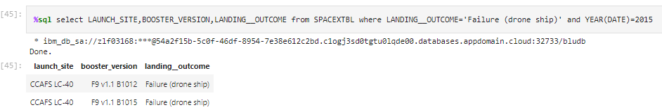
2015 Launch Records
We are listing failed landing outcomes in drone ship, their booster versions, and launch site names for in year 2015.
In where clause we are using ‘AND’ operator to place between two conditions.
Since we only need Year from Date column we are using year() on Date column.

Slide 33
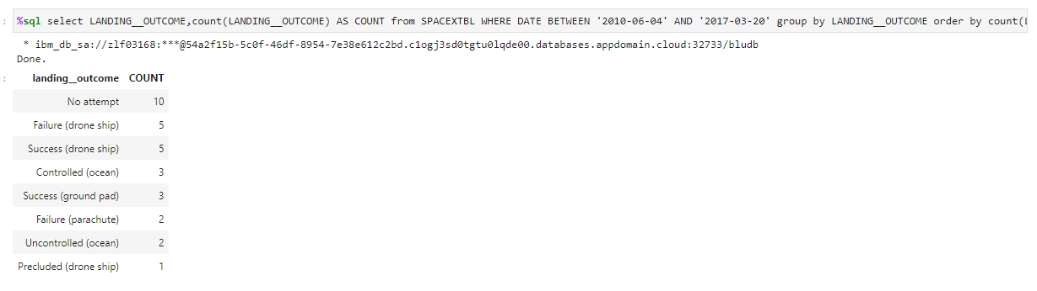
Rank Landing Outcomes Between 2010-06-04 and 2017-03-20
Here we are ranking the count of landing outcomes between the date 2010-06-04 and 2017-03-20, in descending order.
In the query we are using count() to count the number of total landing outcomes and in where clause we are using group by clause on landing outcome, and order by clause on total count of landing outcomes. To display the results in descending order we are using DESC keyword.

Slide 34

Section 3

Slide 35
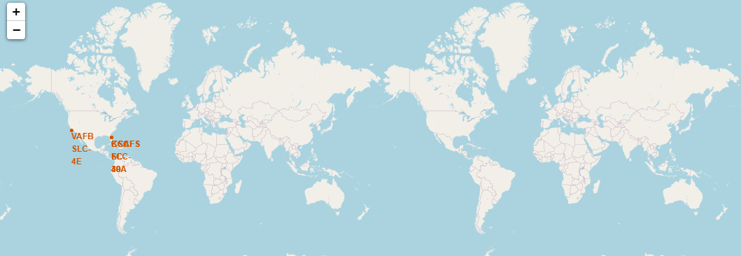
GLOBAL MAP MARKERS FOR ALL LAUNCH SITES
The SpaceX launch sites are in The United States of America’s coasts Florida and California.

Slide 36

Markers showing launch sites with color labels

Slide 37

DISTANCE BETWEEN A LAUNCH SITE TO ITS PROXIMITIES

Slide 38

Section 4

Slide 39
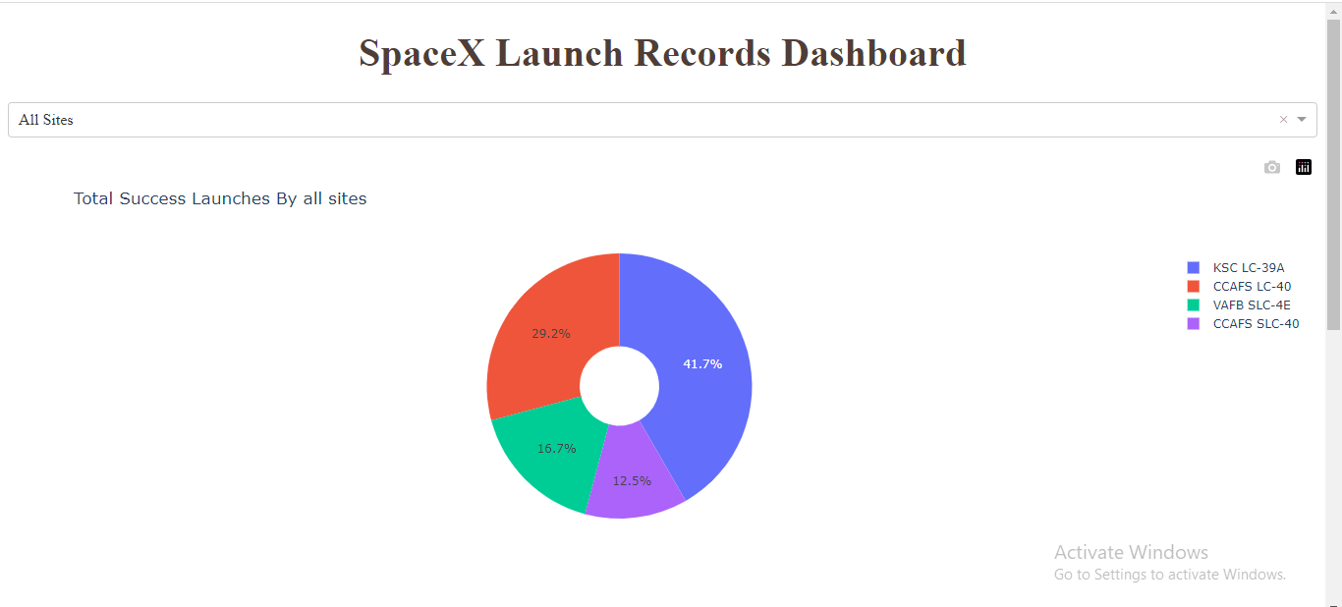
PIE CHART SHOWING THE SUCCESS PERCENTAGE ACHIEVED BY EACH LAUNCH SITE
We can see that KSC LC-39A had the most successful launches from all the sites.

Slide 40

PIE CHART SHOWING THE LAUNCH SITE WITH THE HIGHEST LAUNCH SUCCESS RATIO

Slide 41

PAYLOAD VS. LAUNCH OUTCOME SCATTER PLOT FOR ALL SITES, WITH DIFFERENT PAYLOAD SELECTED IN THE RANGE SLIDER

Slide 42

Section 5

Slide 43
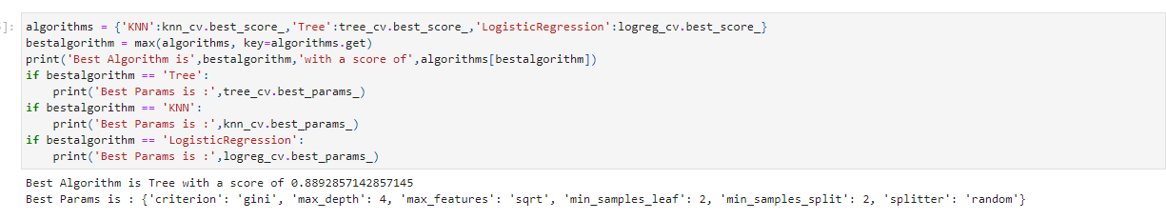
Classification Accuracy
The decision tree classifier is the model with the highest accuracy.

Slide 44

Confusion Matrix
Examining the confusion matrix, we see that Tree can distinguish between the different classes. We see that the major problem is false

Slide 45
Conclusions
The Tree Classifier Algorithm is the best for Machine Learning for this dataset
Low weighted payloads perform better than the heavier payloads
The success rates for SpaceX launches is directly proportional time in years they will eventually perfect the launches
We can see that KSC LC-39A had the most successful launches from all the sites
Orbit GEO,HEO,SSO,ES-L1 has the best Success Rate

Slide 46


